Slide 1
Data 101
Rushabh Jhaveri
NetID: rrj28

Slide 2
Interesting dataset – ufo sightings
URL: https://www.kaggle.com/NUFORC/ufo-sightings
This dataset contains more than 80,000 reports of UFO sightings in the last century, all over the globe.
The data includes the city, state, time, [brief] description, and duration of each UFO sighting.

Slide 3
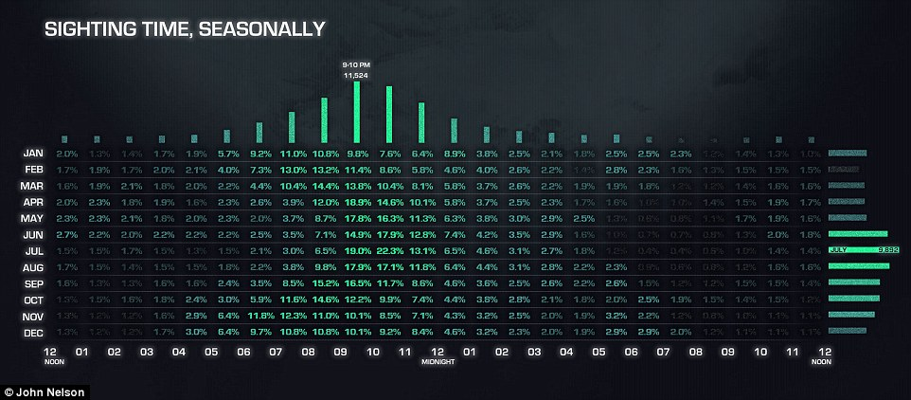
Interesting Uses
This data can be used in an endless number of interesting ways.
I would use this data set to make a plot of UFO sightings against time / weather / light conditions when the eyes are most susceptible to optical illusions.
I would then use this plot to analyze “purported” UFO sightings at such times and try to filter out sightings that are actually just optical illusions / hallucinations.

Slide 4
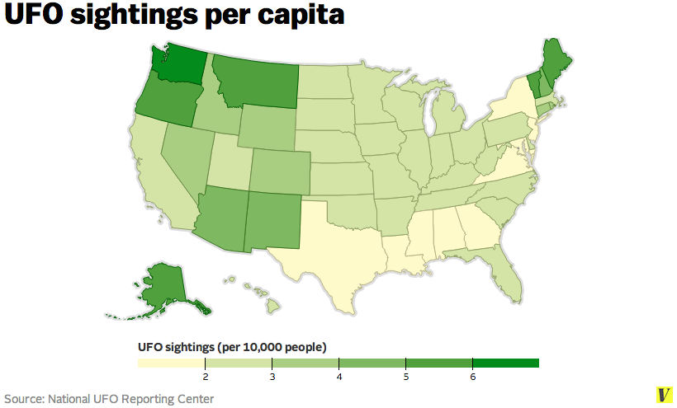
What could this data set be used for?
This data set can be used to answer many interesting questions, such as:
What’s the number of UFO sightings per capita?

Slide 5
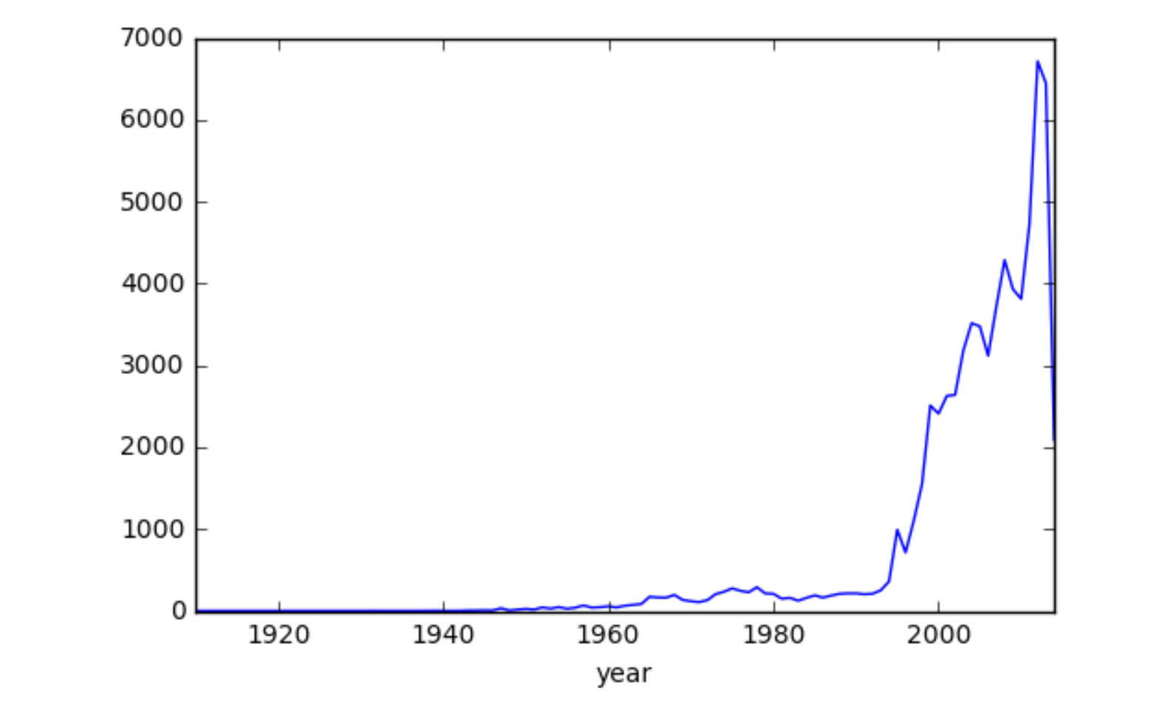
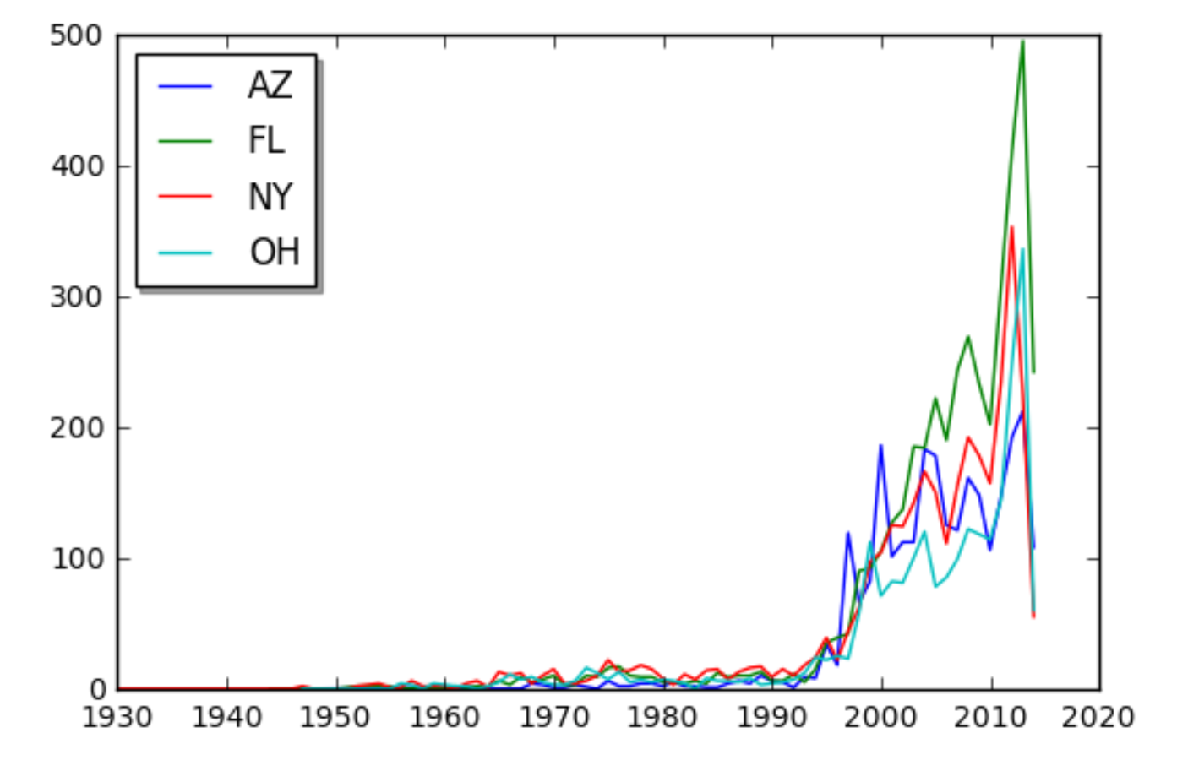
What could this data set be used for? (Contd.)
TO PLOT THE TOTAL NUMBER OF UFO SIGHTINGS PER YEAR
TO COMPARE THE NUMBER OF UFO SIGHTINGS IN DIFFERENT STATES

Slide 6
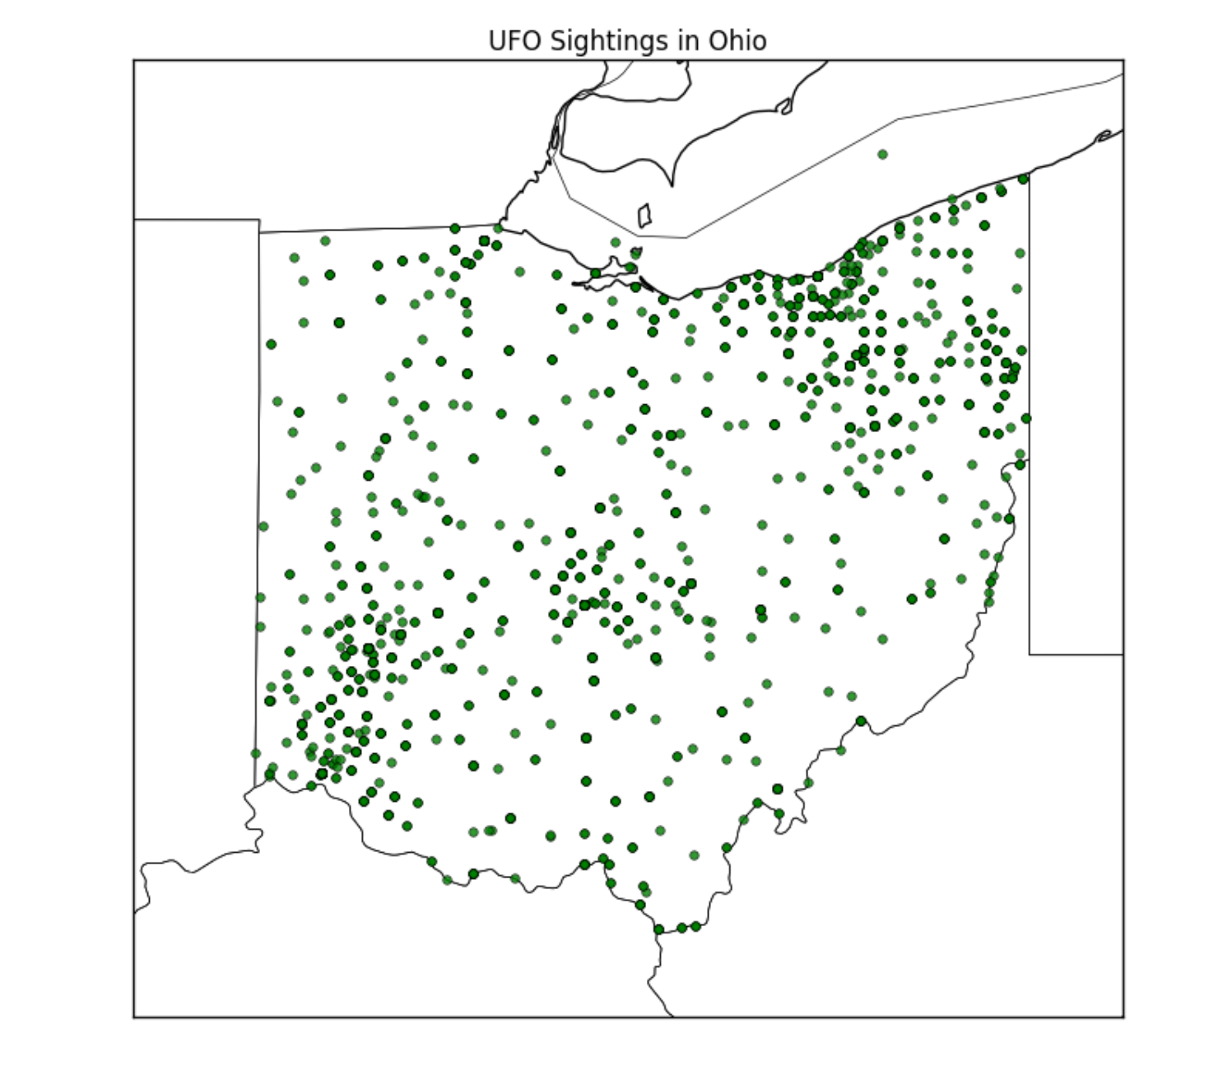
a more complex use
This data can also be used for more complex analysis, such as:
A scatter plot that analyzes the area concentration of UFO sightings in a particular state

Slide 7
conclusion
The data set of UFO sightings is a unique, and definitely unconventional and susceptible to error.
However, it is a strong tool in being able to distill out misattributed “sightings”.
These misattributed sightings can be eliminated as optical illusions, hallucinations, military testing of equipment / weapons, etc.
However, this does not eliminate all the data in this data set, which begs the question..
ARE WE REALLY ALONE?

